Slide 1
I/O techniques and other design issues
An encoder accepts an active level on one of its inputs, representing digit, such as a decimal or octal digits, and converts it to a coded output such as BCD or binary.
Encoders can also be devised to encode various symbols and alphabetic characters.
The process of converting from familiar symbols or numbers to a coded format is called encoding.

Slide 2
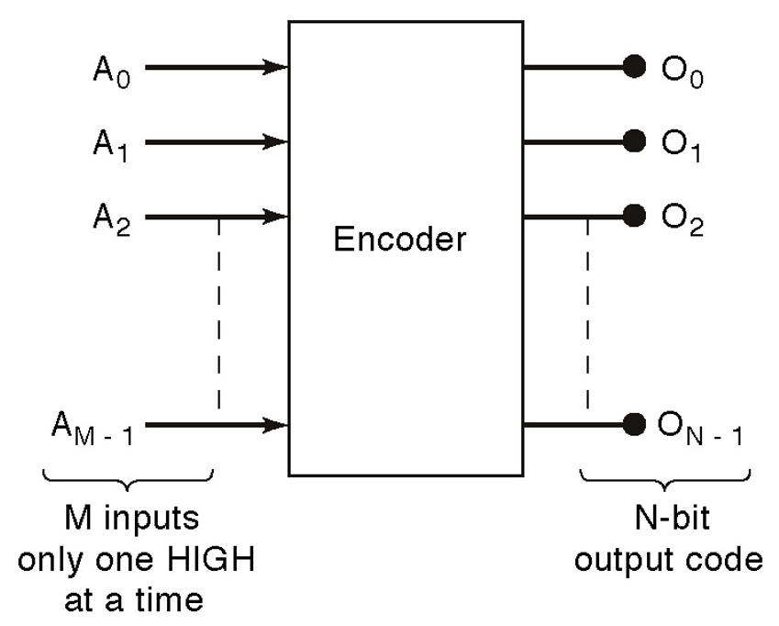
General encoder diagram

Slide 3
Decoder
A decoder is a logic circuit that accepts a set of inputs that represents a binary number and activates only the output that corresponds to the input number.
In other words, a decoder circuit looks at its inputs, determines which binary number is present there, and activates the one output that corresponds to that number ; all other outputs remain inactive

Slide 4
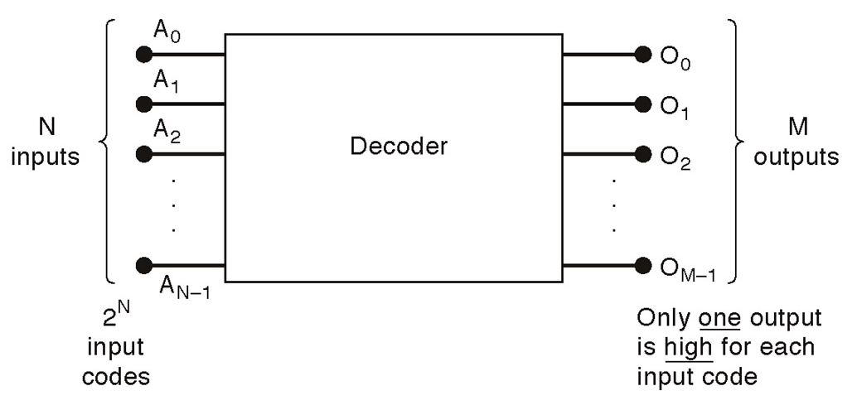
General decoder diagram

Slide 5
I/O techniques and other design issues
ENCODER- a digital circuit that produces a binary output code depending on which of its inputs are activated.
DECODER- a digital circuit that converts an input binary code into a single numeric output.

Slide 6
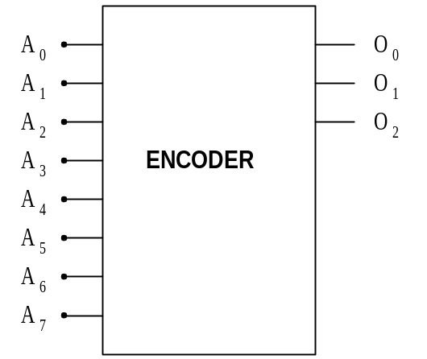
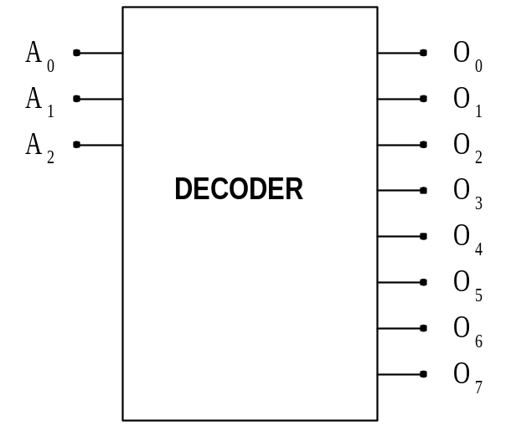
ENCODERS AND DECODERS
ONLY ONE INPUT ACTIVATED AT A TIME
BINARY CODE INPUT
BINARY CODE OUTPUT
ONLY ONE OUTPUT ACTIVATED AT A TIME

Slide 7
The Concept of Multiplexing
Defn: Multiplexing refers to the combination of information streams from multiple sources for transmission over a shared medium.
Defn: Demultiplexing refers to the separation of a combination of information streams back into separate information streams

Slide 8
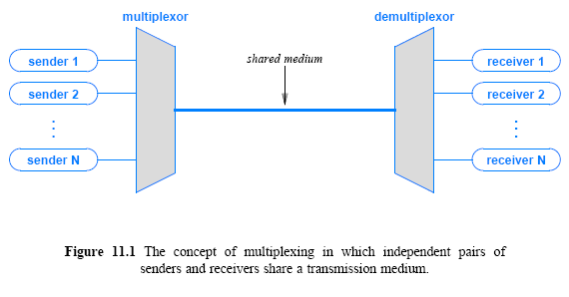
Cont..

